Slide 1
Future-Ready Energy Analytics Predicting and Optimizing Household Energy Usage in a Changing Climate
Group 4
Abhishek Namana
Hang Tian
Revanth
Biswadip
Aadit

Slide 2
Business Question Plot of the story
"How can we accurately predict and manage future energy usage in single-family houses, particularly in the context of rising temperatures, to optimize energy efficiency and reduce costs?"

Slide 3
Data Overview
Data.
Initial combined data set :
Rows-4248280 rows
Columns – 133 columns
Predictors.
Total energy usage(sum of the energy usage from all the appliances in each house from different counties in the month of July)
Source.
Static House Data: https://intro-datascience.s3.us-east-2.amazonaws.com/SC- data/static_house_info.parquet
Energy Usage Data: https://intro-datascience.s3.us-east-2.amazonaws.com/SC-data/2023- houseData/102063.parquet
Weather Data: https://intro-datascience.s3.us-east-2.amazonaws.com/SCdata/weather/2023-weather-data/
Meta Data: https://intro-datascience.s3.us-east-2.amazonaws.com/SCdata/data_dictionary.csv

Slide 4
Exploratory Data Analysis
The story of Data

Slide 5
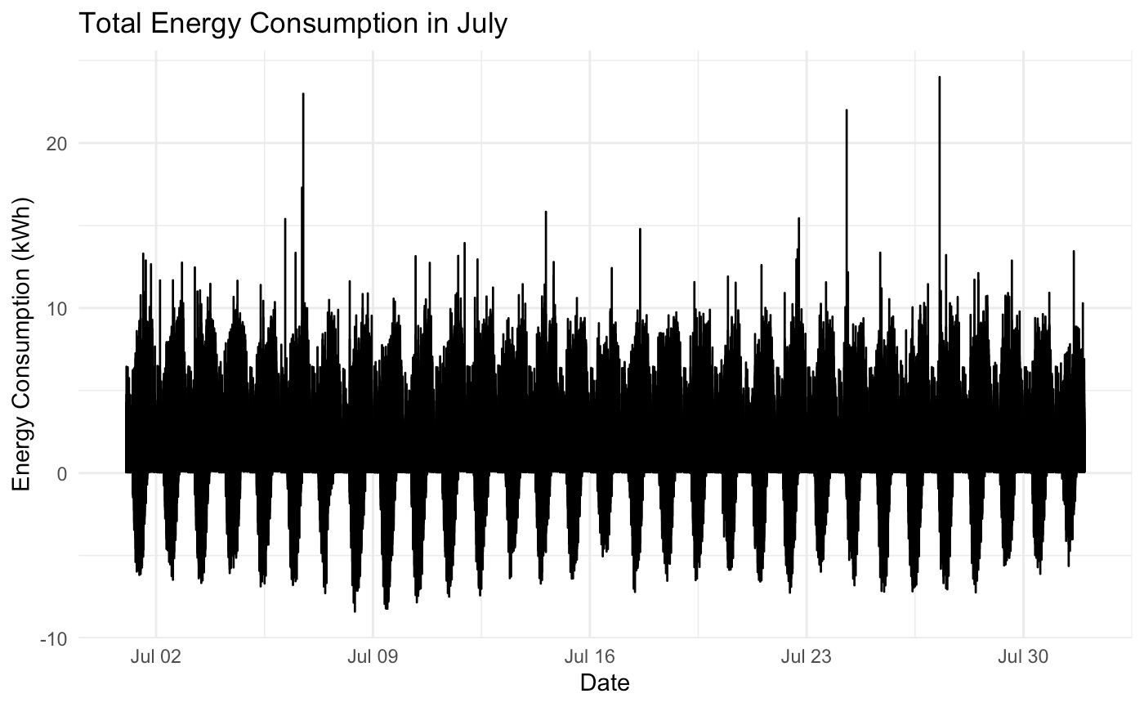

Slide 6
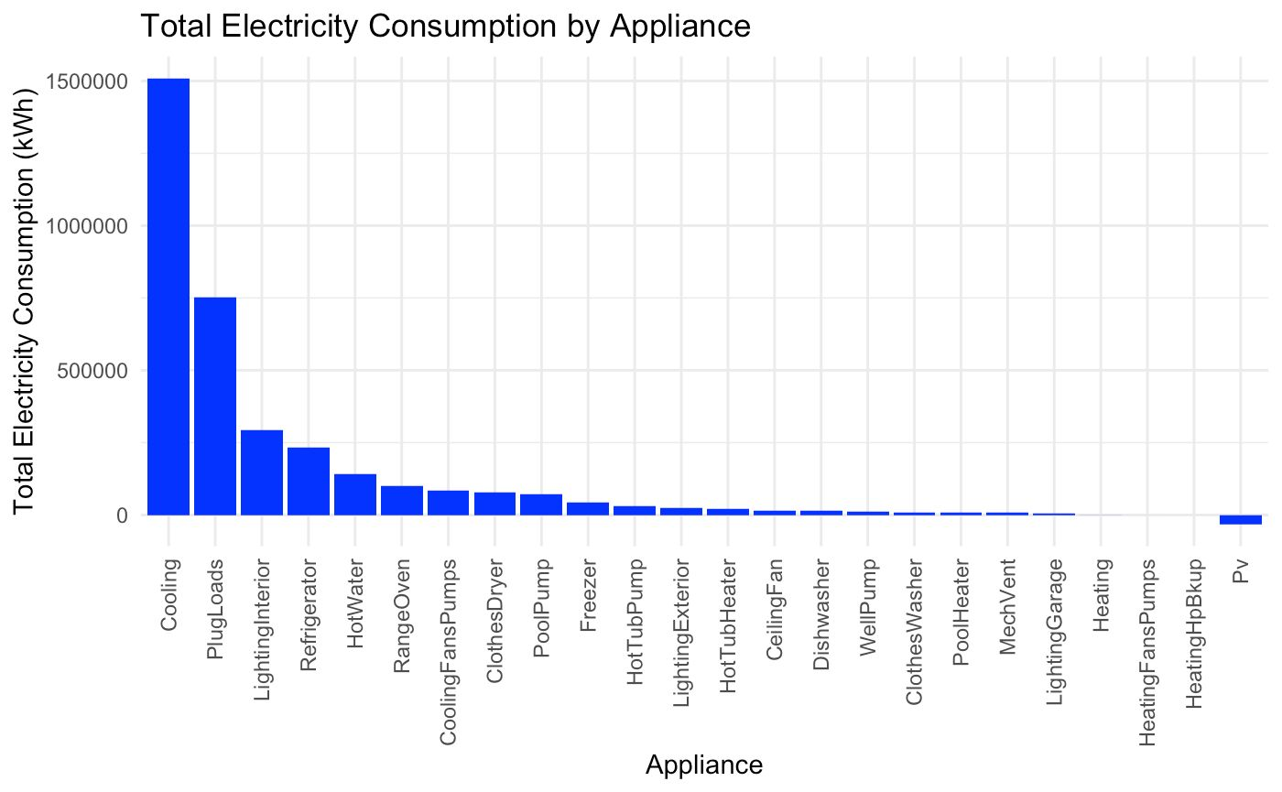

Slide 7
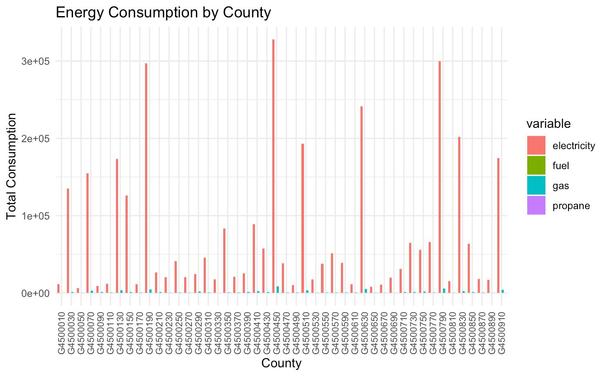

Slide 8
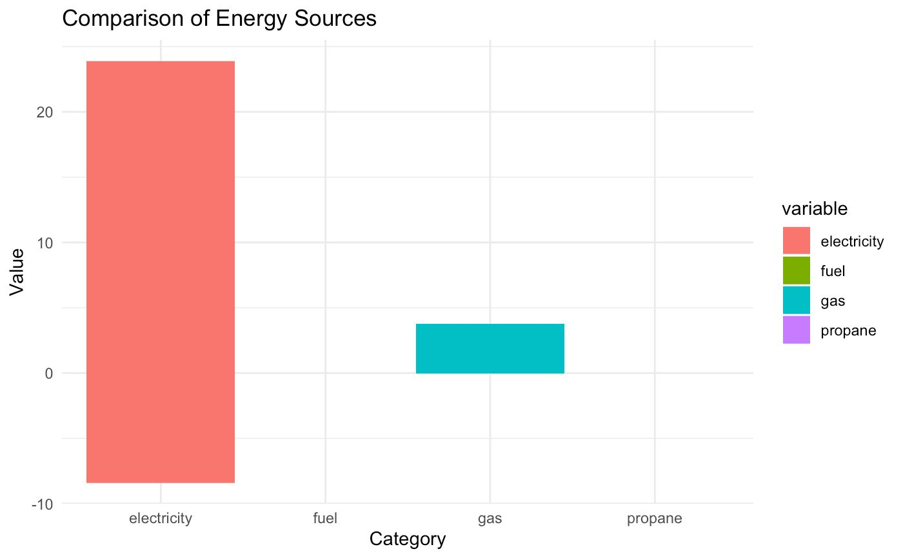

Slide 9
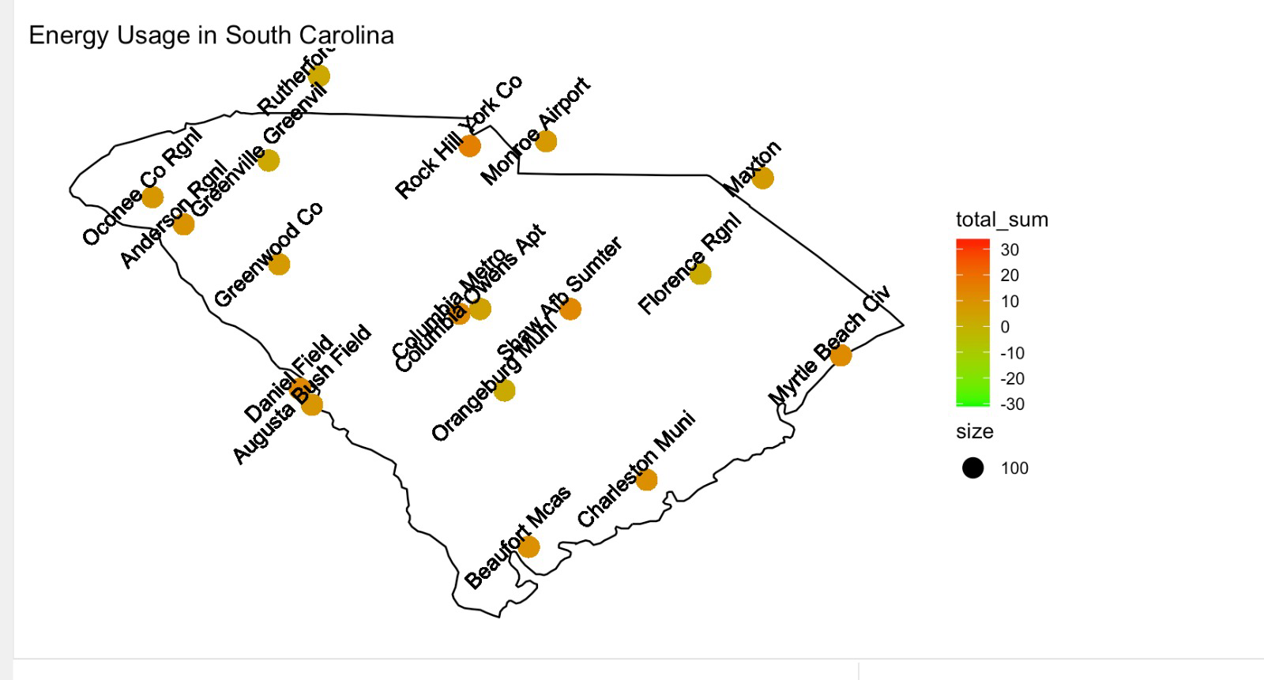

Slide 10
Modeling Crafting our Story
1
2
⁠LASSO Regression
Linear Regressor
3
4
Ridge Regression
⁠Elastic Net Regression

Slide 11
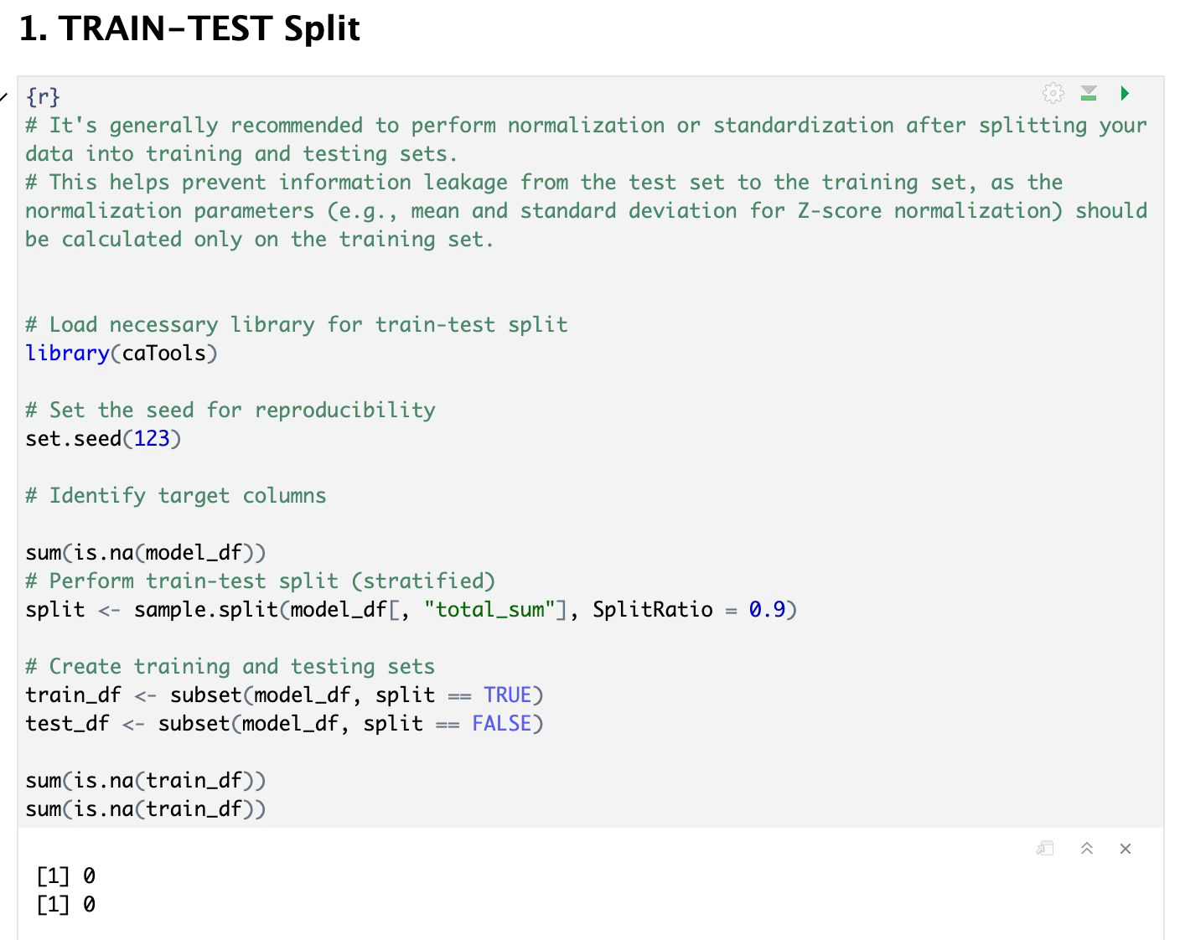

Slide 12
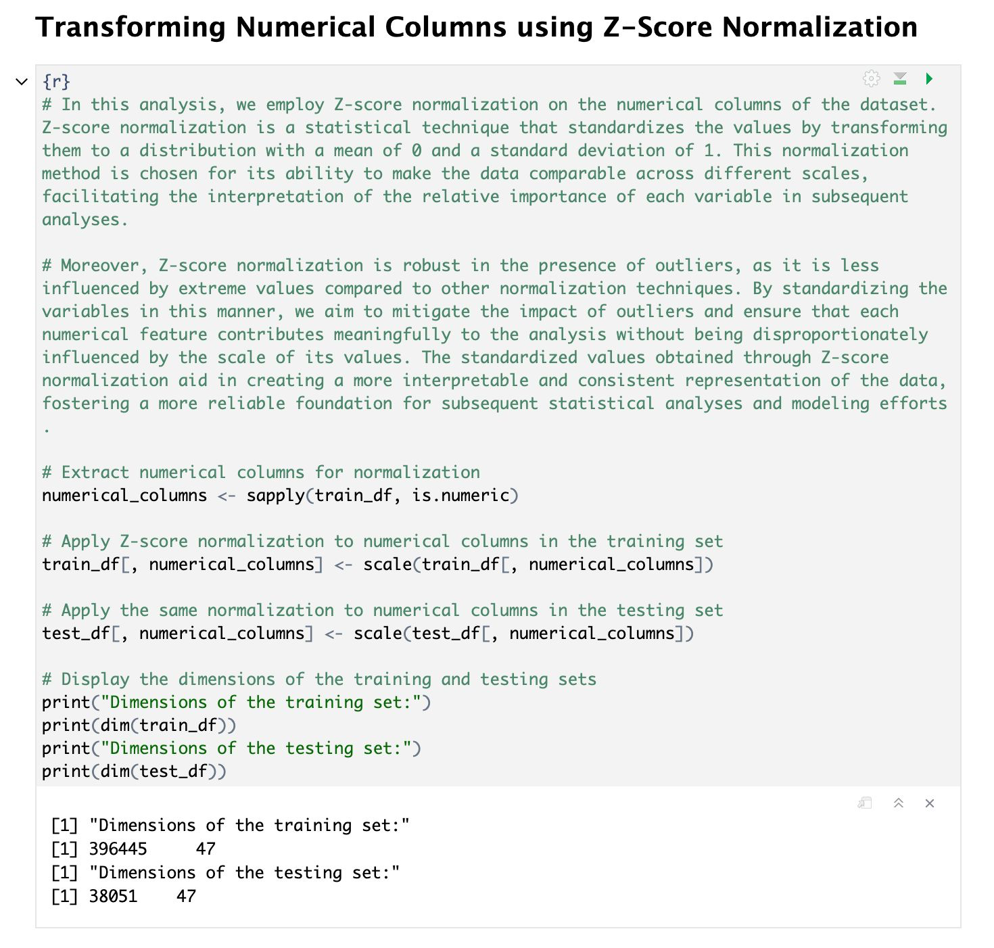

Slide 13
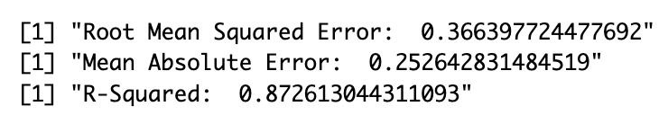
1
LASSO Regression
Lasso helps in building simpler models by eliminating less relevant features.
It prevents overfitting by reducing the model's complexity.
Useful when you suspect that only a subset of features is important.
Performs feature selection by setting some coefficients to exactly zero.

Slide 14
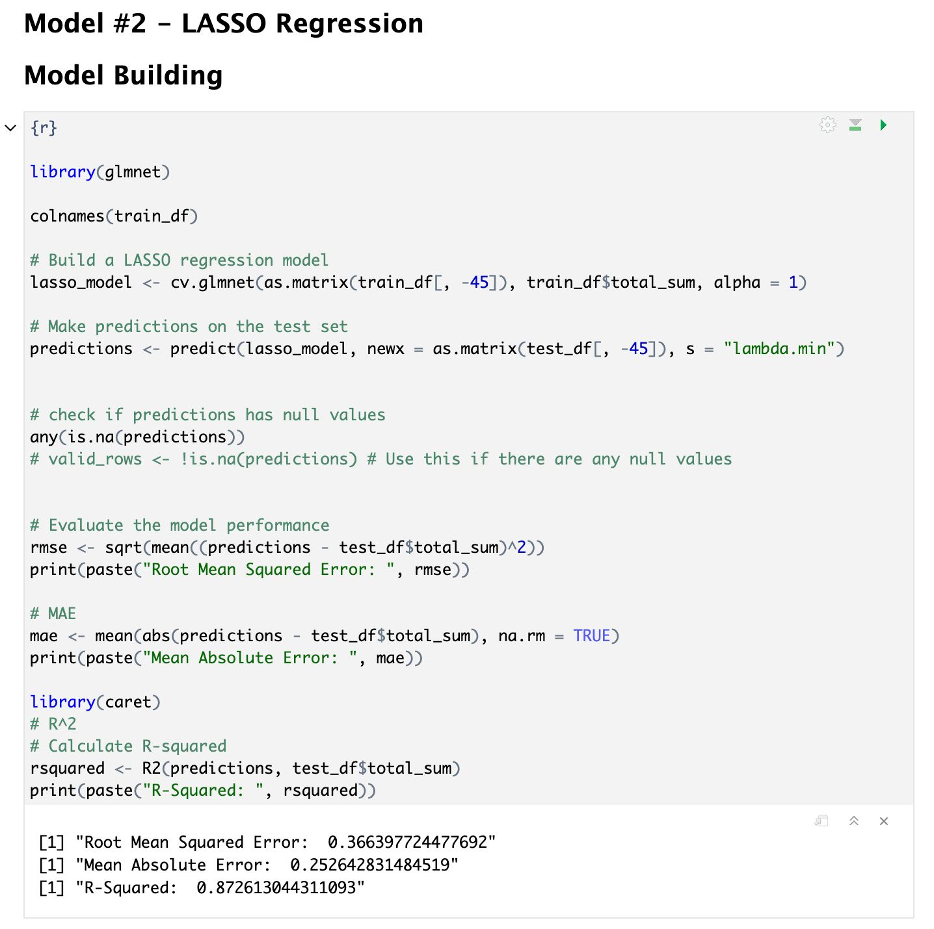

Slide 15
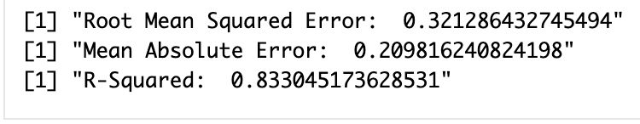
2
Linear Regression
Good for datasets with a linear relationship between features and target.
Assumes that the relationship between variables is linear, which may not capture complex patterns.

Slide 16
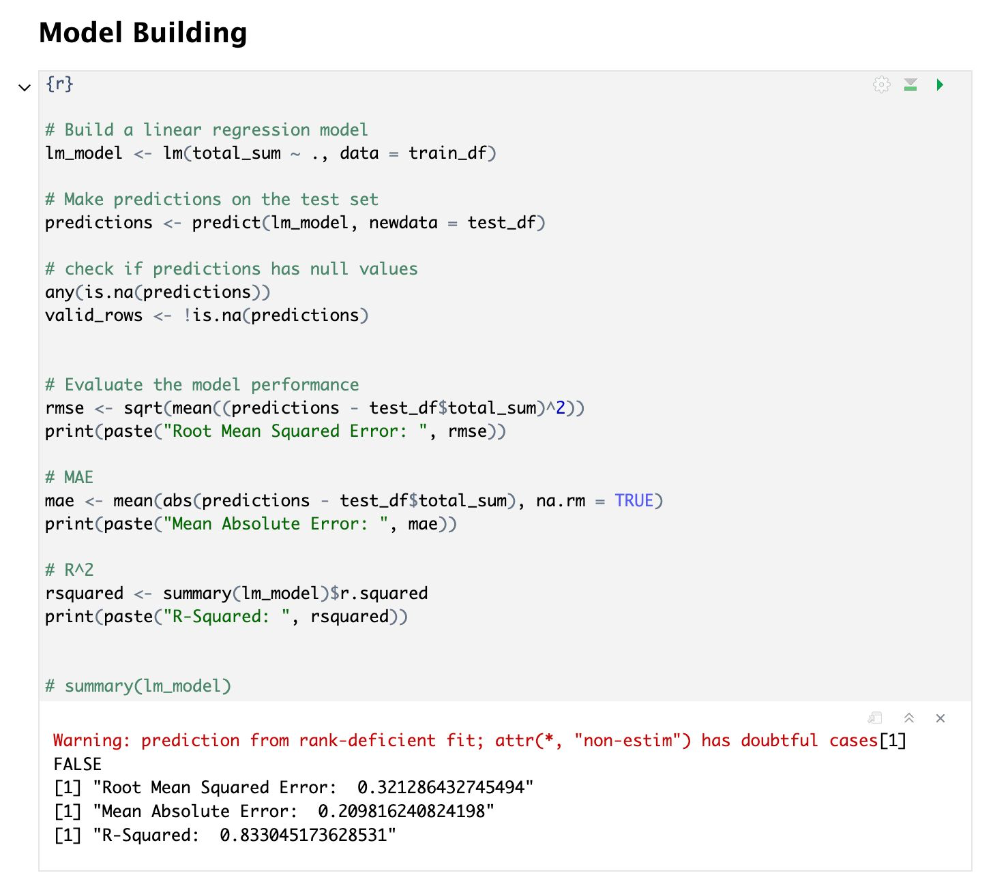

Slide 17
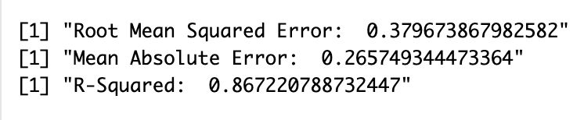
3
Ridge Regression
Effective when dealing with multicollinearity (high correlation between features).
Can help prevent overfitting by penalizing large coefficients.

Slide 18
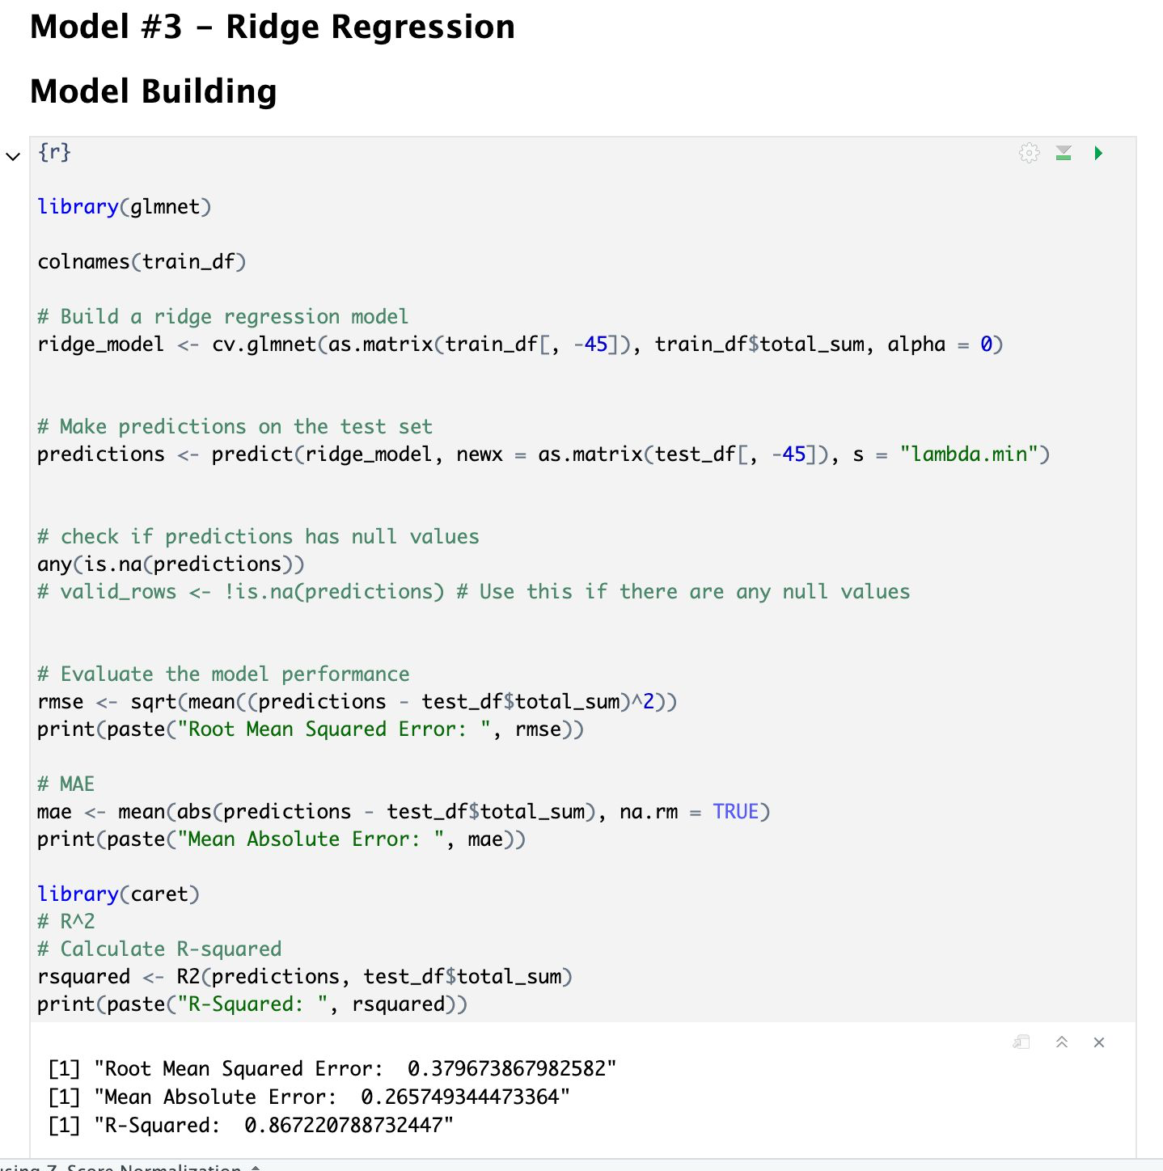

Slide 19
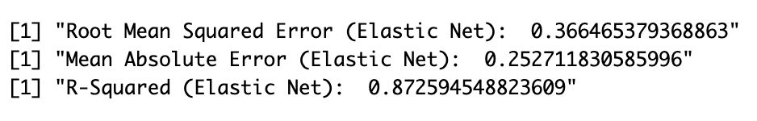
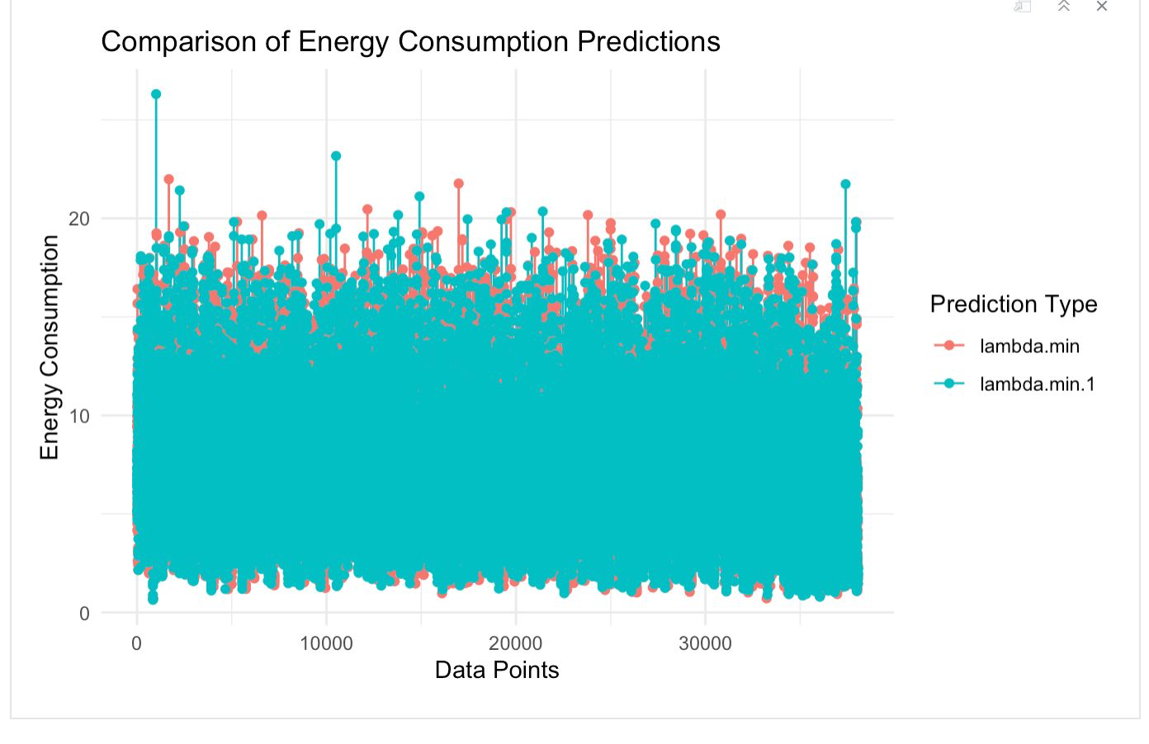
4
⁠Elastic Net Regression
Combines the advantages of LASSO and Ridge, suitable for a wide range of datasets.
Provides a balance between feature selection and handling multicollinearity.

Slide 20
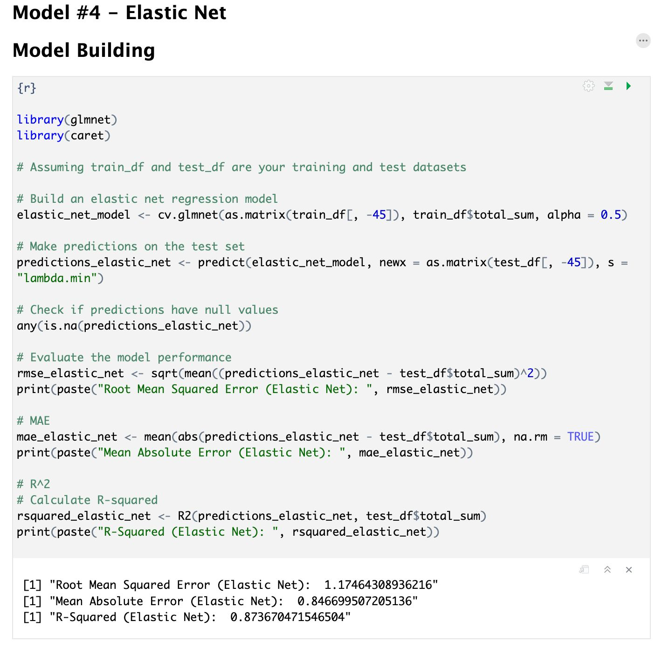

Slide 21
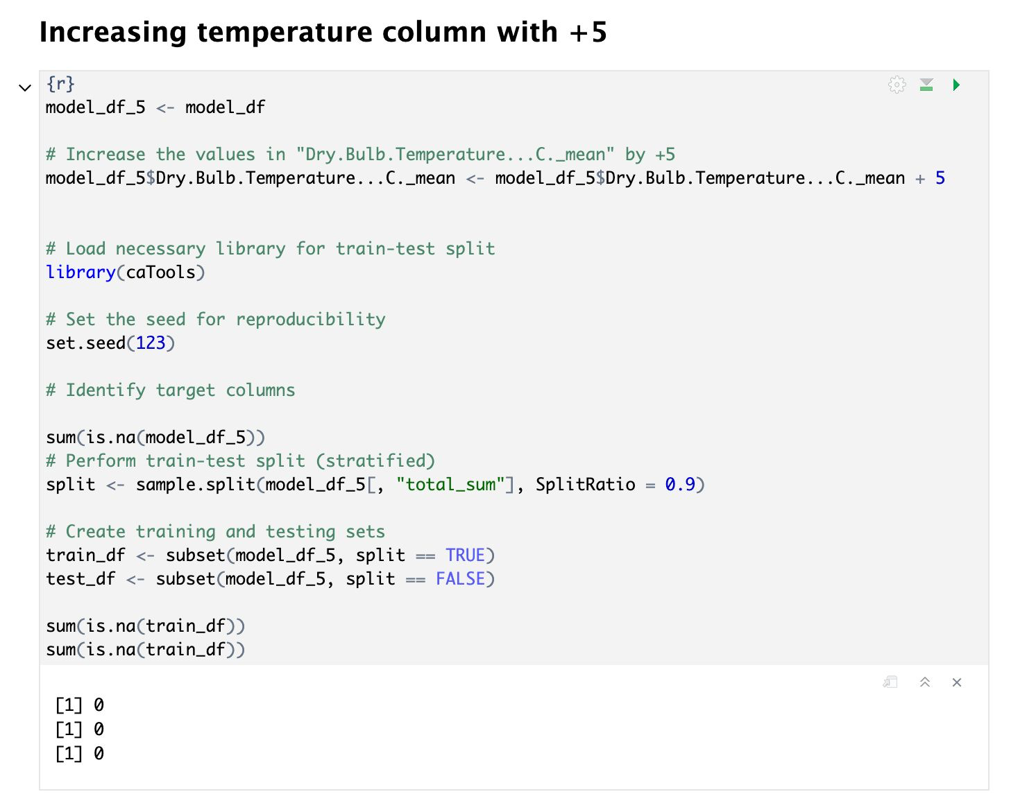

Slide 22
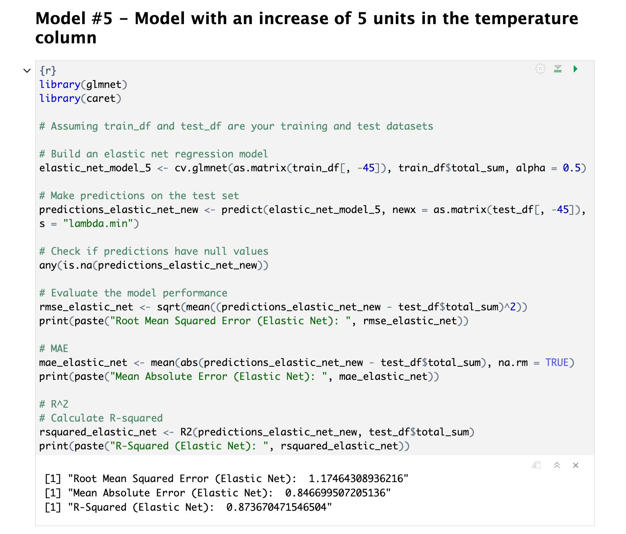

Slide 23
Interpretation Story Of Insights
01
02
In general , when the temperature increased by 5 degree the energy fluctuations were quite random
Looking at the most significant variables in model heating appliances have significant affect on the energy usage, as a result the energy usage at night is higher than other time of the day

Slide 24
Highest correlation variables which affect the trends
- in.cooling_setpoint
- in.cooking_range
- in.heating_setpoint
- in.hot_water_fixtures
- in.infiltration
- in.vintage

Slide 25
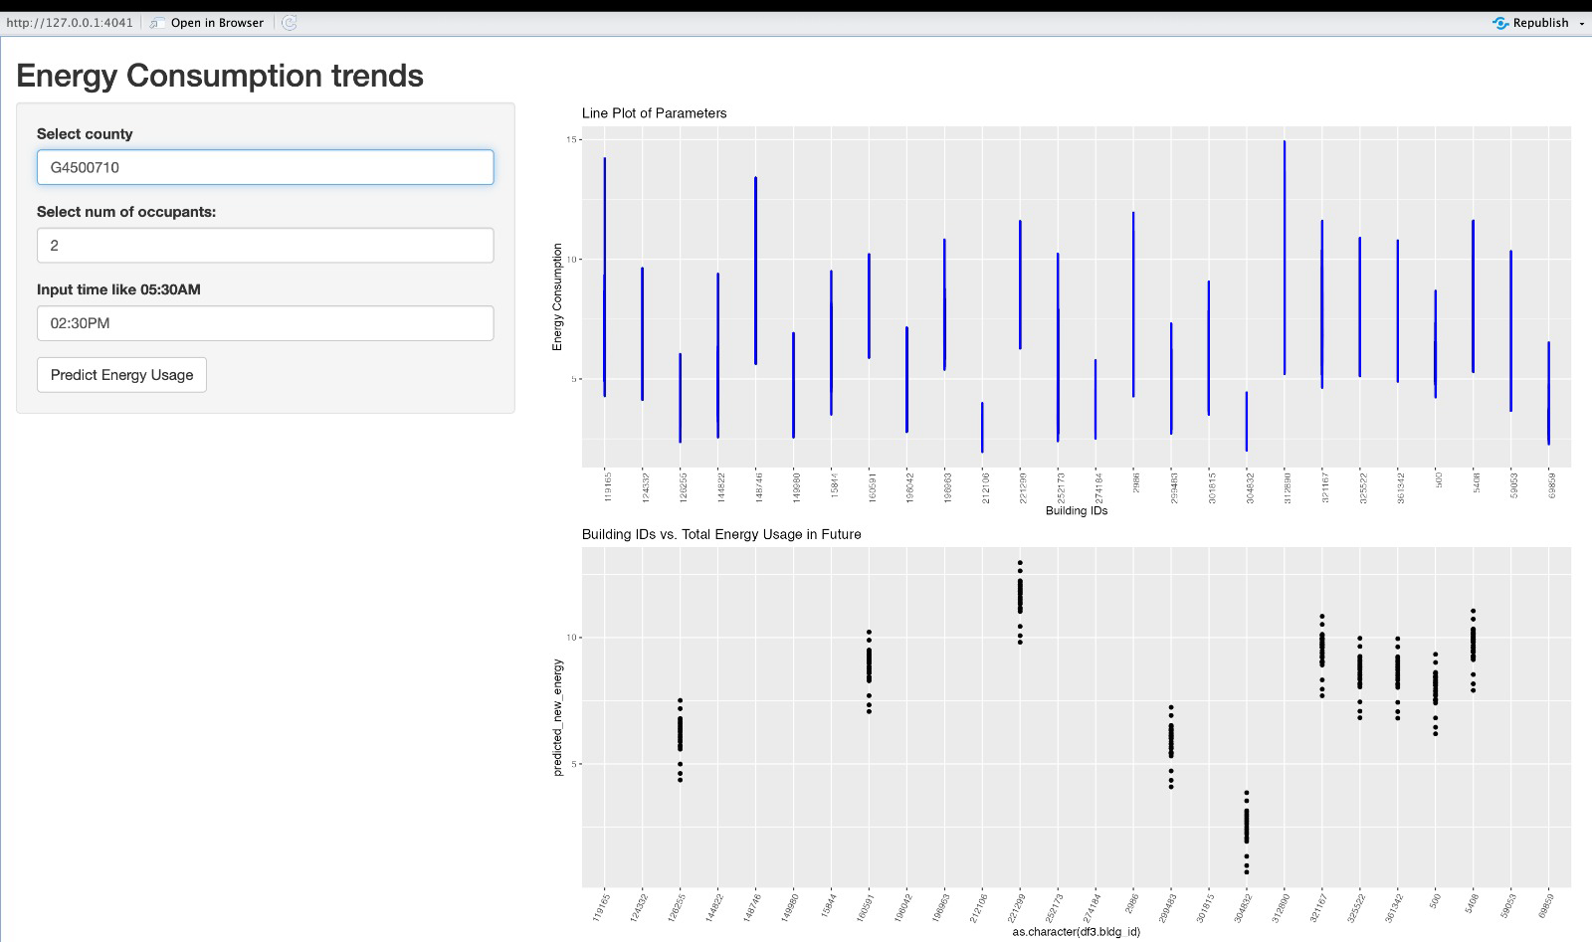
Shiny App

Slide 26
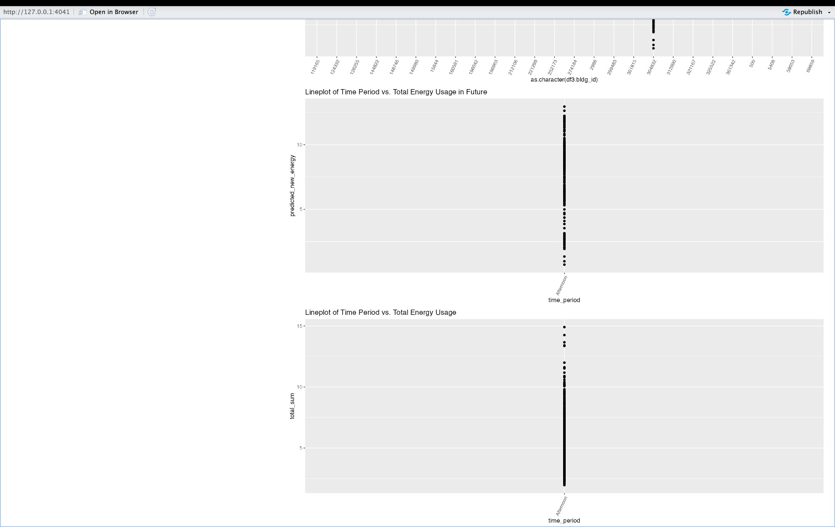

Slide 27
Conclusion
We were able to analyze the energy consumption across counties
We used 4 different models to find the best model and predict the energy usage
We were able to predict the energy usage when the temperature is increased by 5 degree
Recommendations
Raise awareness on using the cooler in house holds.
In colder regions – take good care of the insulations of home.
Replacing old appliances which consume a large amount of energy

Slide 28
Thank you!

